Slide 1
Revisiting Batch Normalization in Quantization of Super-Resolution Networks
Myungjun Son
School of Electrical Engineering,
Korea University
Dongjea Kang
School of Electrical Engineering,
Korea University
Hongjae Lee
Department of Electrical Engineering,
Korea University
Jun-Sang Yoo
Department of Electrical Engineering,
Korea University
Seung-Won Jung*
Department of Electrical Engineering,
Korea University
Notes:
Good day, everyone. I am Myungjun Son, an undergraduate student of Korea university, and I am very honored to introduce my research to you guys, titled Revisiting Batch normalization in Quantization of Super resolution Networks.

Slide 2
Index
1
Preliminary
2
Introduction
3
Impact of Normalization
on Quantization
4
Experiments
What is Super-Resolution?
What is Normalization?
What is a Residual Network?
What is Quantization?
Emergence of EDSR
Should BN be eliminated?
Limit of Quantization Unfitness
Downscaling of Quantization interval
Comparison with PAMS
Comparison with DDTB
5
Conclusion
6
References
Summary of Experiment
Further research
Notes:
Here is an index for my presentation. First, we will have a look at some preliminaries that allows you to understand what I am going to say better. Next, I will tell you about the motivation of this research, and our observation about the impact of normalization on quantization. Experiments and conclusion explanation will follow up.

Slide 3
Preliminary
What is Super-Resolution?
What is Quantization?
What is Normalization?
What is a Residual Network?
Notes:
Firstly, let’s have a quick look at preliminaries. In this chapter, I will give you some brief explanations about following four topics.

Slide 4
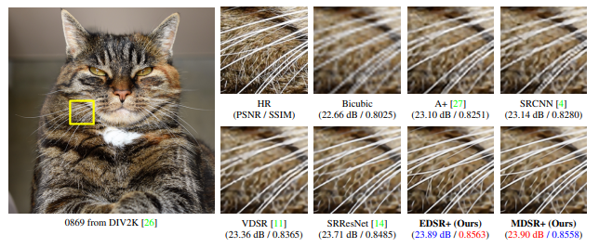
What is Image Super-Resolution?
Lim, Bee, et al. “Enhanced deep residual networks for single image super-resolution”
a1 |  | a2 |  | a3
b1 |  | b2 |  | b3
c1 |  | c2 |  | c3
a1 |  | a2 |  | a3
b1 |  | b2 |  | b3
c1 |  | c2 |  | c3
a1 | a2 | a3
b1 | b2 | b3
c1 | c2 | c3
Notes:
First is about “what is super resolution?”
Super resolution is a huge research topic for generating High resolution images from low resolution images.
For example, if we try to make two times bigger image, what we can use is only 25% of pixels and we need to find last 75% of pixels.
Recent researches take ML techniques to solve this problem and lead to better performance than bicubic interporlation.

Slide 5
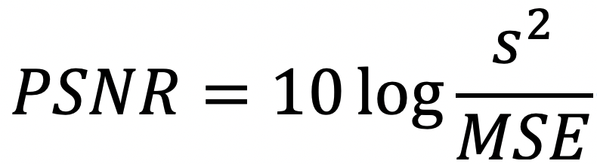
What is Image Super-Resolution?
Lim, Bee, et al. “Enhanced deep residual networks for single image super-resolution”
(dB)
PSNR of image A is 1dB higher than that of B
= A is 10 times better than B
= A is 10 times more similar to GT than B
Notes:
We use PSNR as a metric for model performance, which is based on MSE error with log scale.
1dB higher means that the model performance is 10 times better.

Slide 6
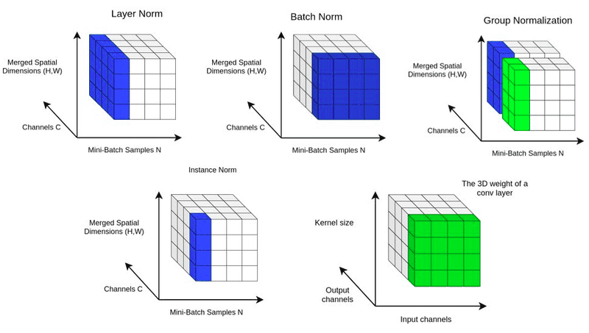
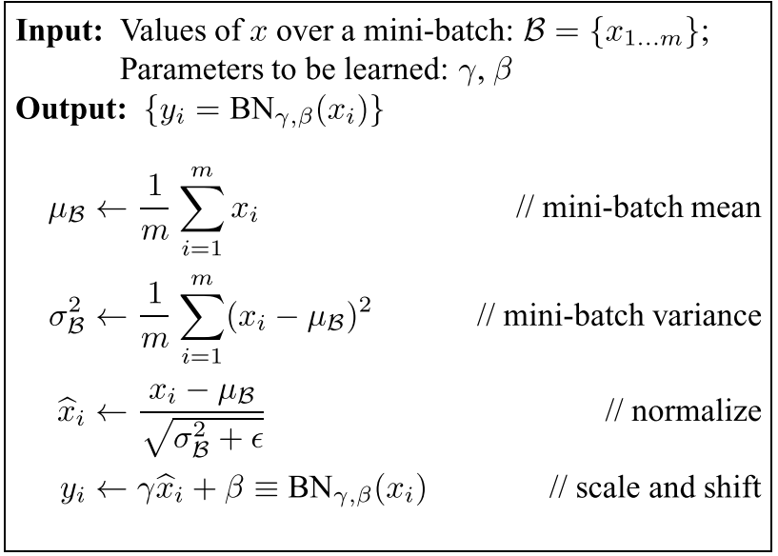
What is Normalization?
Ioffe, Sergey, and Christian Szegedy. "Batch normalization: Accelerating deep network training by reducing internal covariate shift."
https://theaisummer.com/normalization/
Enable applying higher learning rate
Make it easier to find loss surface
Improve model performance
1) Reduce Internal Covariate Shift (S. Ioffe, 2015)
2) Make Loss function more Lipschitz-continuous (S. Santurkar, 2018)
Notes:
Second topic is about “What is normalization?”
I think almost everyone here knows well about this, so I will pass this slide
Normalization makes activation distribution like a standard normal distribution.

Slide 7
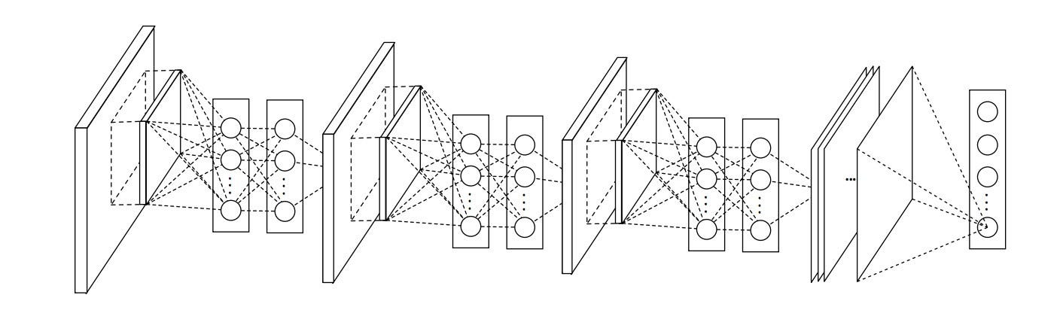
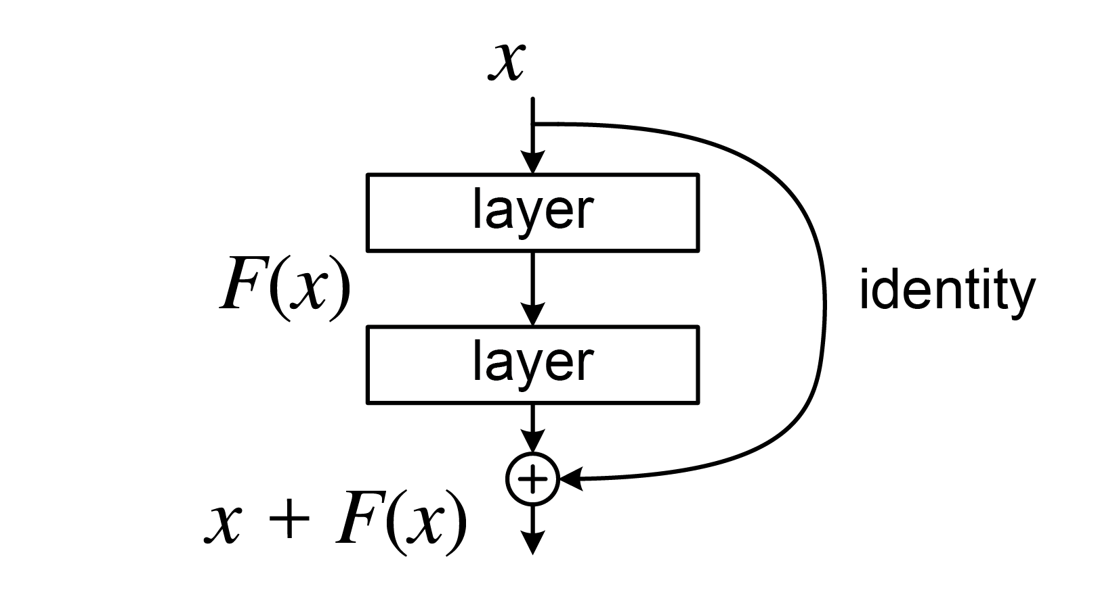
What is a Residual Network?
https://github.com/getmykhan/DCNN
Making network deeper and deeper led to a quick reduction in training accuracy
“Degradation problem”
Skip connection allows stacking more layers
https://en.wikipedia.org/wiki/Residual_neural_network
Notes:
Here is third topic which is about what is a residual network.
As Deep learning networks gets deeper and deeper, the degradation problem has emerged.
Researchers are trying to work this out with adding skip connection path, and we call this form of network as a residual network.

Slide 8
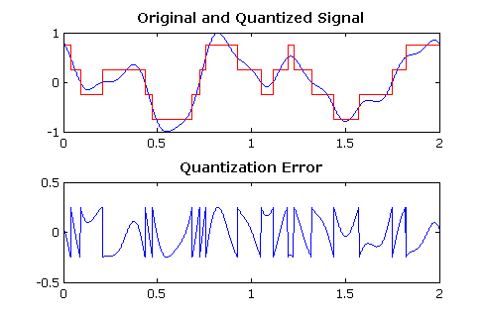
What is Quantization?
D. Ventzas, “PEAK SEARCHING ALGORITHMS and APPLICATIONS”
Continuous Signal
Discrete Signal
Analog Signal
Digital Signal
Notes:
The last subject is about ‘what is quantization’, which is the most important part of this chapter.
In signal processing, quantization means a transform from continuous or analog signal to discrete to digital signal.

Slide 9
What is Quantization?
Quantize weights and activation values
Requires many many BitOPs
FP32
FP32
Requires only a few BitOPs
Int (n-bits)
Int (n-bits)
Quantization make it possible to get similar results
with extremely less BitOPs
Notes:
Then, What does it mean, “apply quantization on a model?”
That means, quantize weights and activation values in training and inference process.
As Deep learning calculations are based on matrix operations, especially matrix multiplication, which requires vast amount of floating point multiplication.
If we make weight and activation values to Integer by quantization, then we can reduce the BitOps, but due to quantization error, model performance will damaged.
Thus researchers are now trying to find a good quantization algorithm which can reduce quantization error.

Slide 10
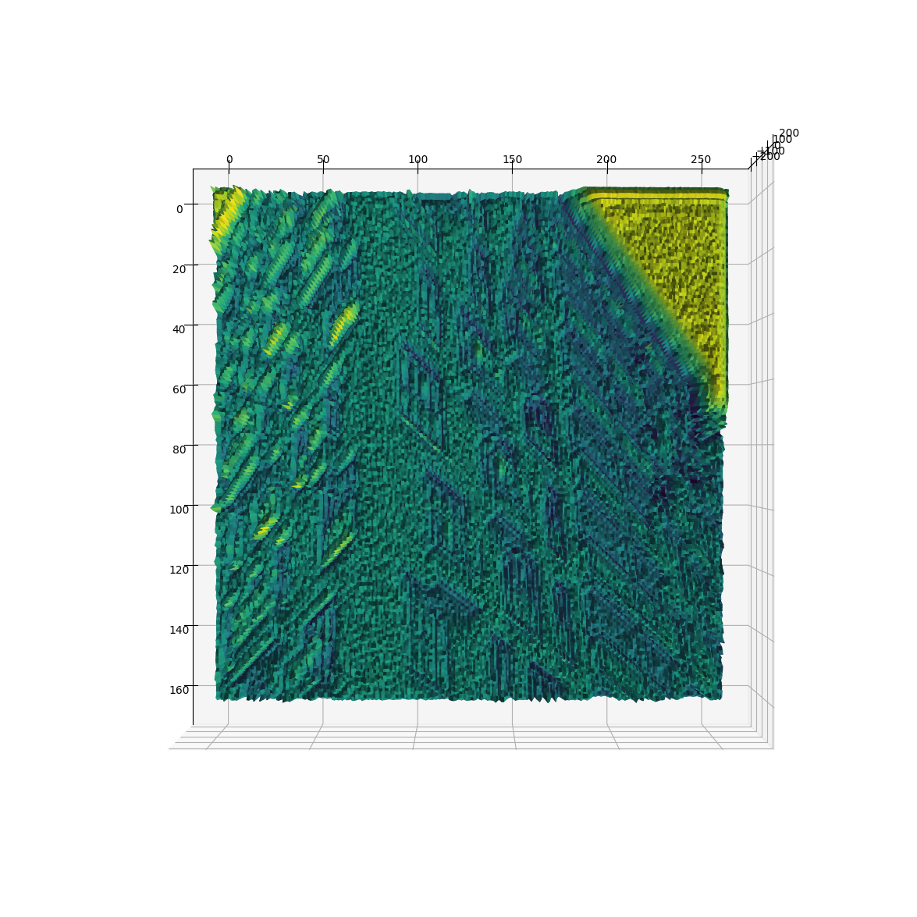
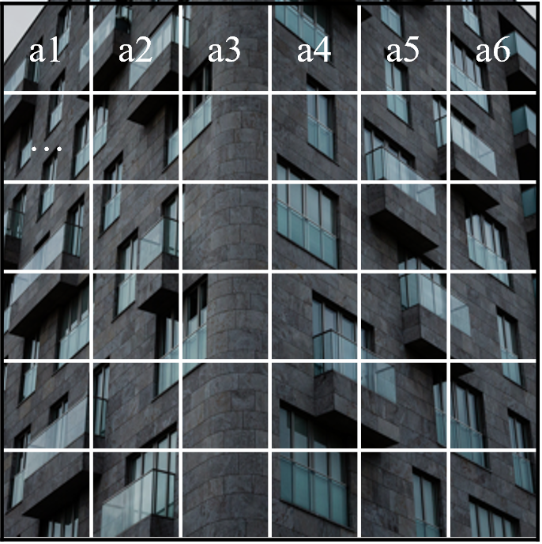
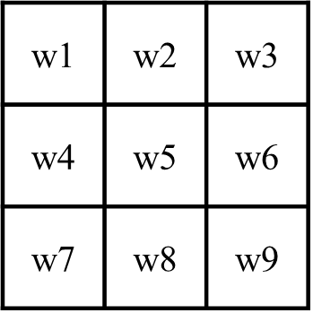
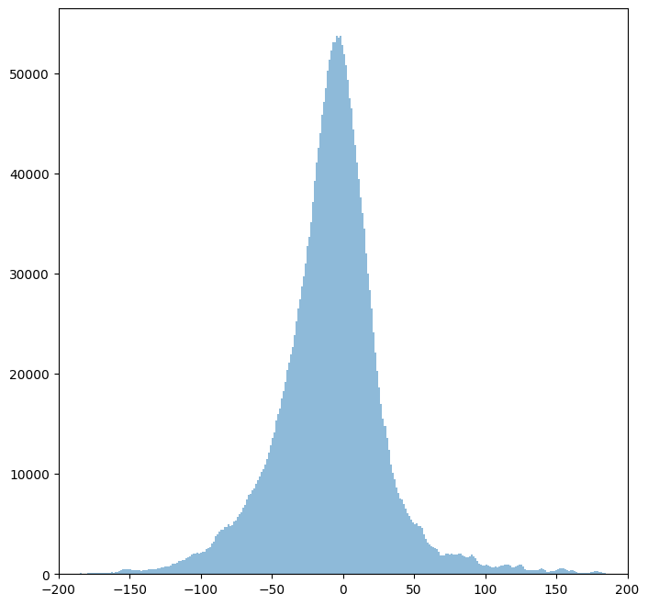
What is Quantization?
*
=
Kernel
Image
Activation
Histogram of activation
Notes:
Let’s have a look at how quantization works.
We can get activation values by taking convolution with image and kernel, and we can make a histogram of activation.

Slide 11
What is Quantization?
count
0
1
2
3
4
5
6
7
8
9
10
11
12
13
14
15
16
17
18
19
20
21
22
23
24
25
26
27
28
29
30
31
value
0000
0001
0010
0011
0100
0101
0110
0111
1000
1001
1010
Histogram of activation
Notes:
So let’s assume we have this gaussian distribution like activation.
Actually, this curve is consists of many floating point, so we can draw this graph like this
we can choose some representative values, what we call them as quantization level, map those representative floating point values to binary integer values and quantize adjacent values to nearest quantization level

Slide 12
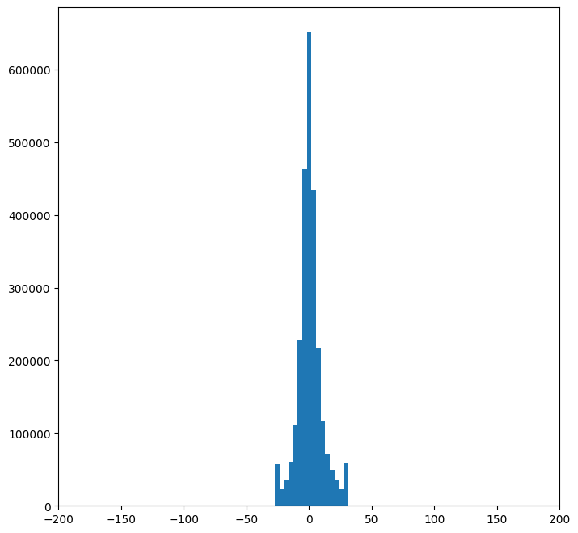
What is Quantization?
count
0
1
2
3
4
5
6
7
8
9
10
11
12
13
14
15
16
17
18
19
20
21
22
23
24
25
26
27
28
29
30
31
value
0000
0001
0010
0011
0100
0101
0110
0111
1000
1001
1010
Quantization is a kind of mapping,
from FP32 to Int
Notes:
We can get this shape of graph, and finally we can quantize floating point based activations to integer quantization levels

Slide 13
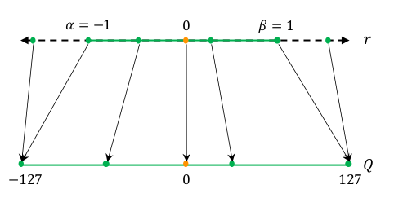
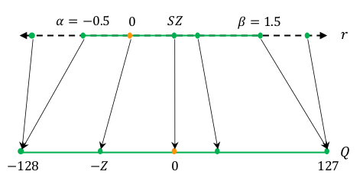
What is Quantization?
Gholami, Amir, et al. "A survey of quantization methods for efficient neural network inference."
Symmetric Quantization
Asymmetric Quantization
PAMS
Quantized Super-Resolution via Parameterized Max Scale
(2020)
DDTB
Dynamic Dual Trainable Bounds for Ultra-low Precision Super-Resolution Networks
(2022)
Notes:
This slide explains two majority quantization scheme, symmetric and asymmetric quantization.
In symmetric quantization, quantization range is symmetric, on the other hand, in asymmetric quantization, quantization range is asymmetric.
PAMS and DDTB are most influential researches for each scheme

Slide 14
What is Quantization?
Given a quantization bit precision (2, 4, 8, …),
Finding appropriate quantization range is important
to minimize quantization error.
Notes:
If you understand previous slides, you can easily find that the most important point in quantization is
Finding appropriate quantization range

Slide 15
Introduction
Emergence of EDSR
Should BN be eliminated?
Notes:
From now, i will tell you about the motivation of our research.

Slide 16
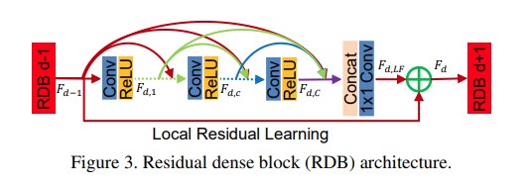
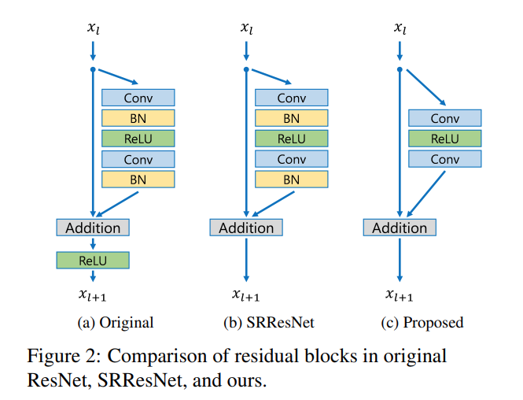
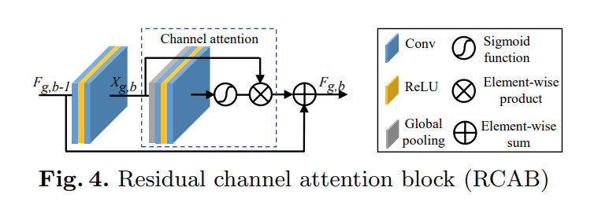
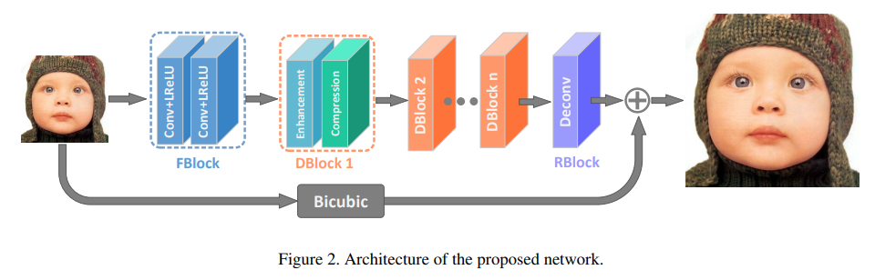
Emergence of EDSR
RDN
Zhang, Yulun, et al. "Residual dense network for image super-resolution."
RCAN
Zhang, Yulun, et al. "Image super-resolution using very deep residual channel attention networks.”
Lim, Bee, et al. “Enhanced deep residual networks for single image super-resolution,”
EDSR
IDN
Hui, Zheng, Xiumei Wang, and Xinbo Gao. "Fast and accurate single image super-resolution via information distillation network."
Notes:
In 2017, a residual network based super resolution model, titled EDSR won the first prize of NTIRE 2017 SISR challenge.
EDSR removed Normalization layer from SRResNet and achieved high performance.
Following SR models like RDN, RCAN, IDN thus decided to exclude normalization layer from their networks too.

Slide 17

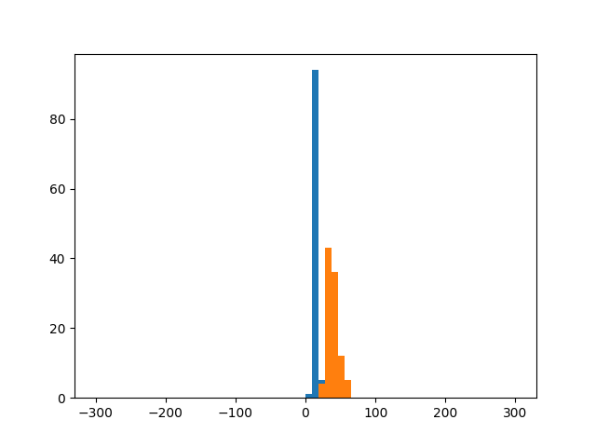
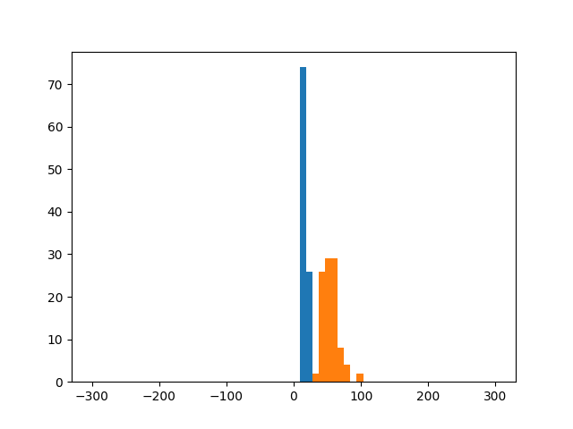
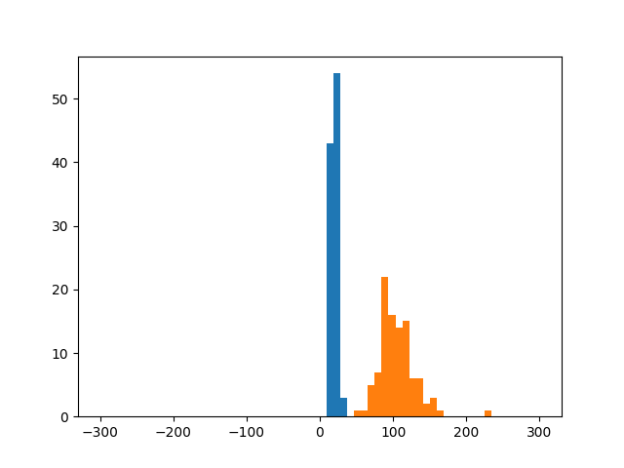
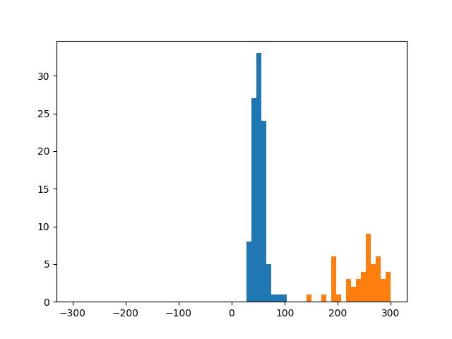


Should BN be eliminated?
EDSR
Conv
ReLU
Conv
$$⋯$$
Conv
ReLU
Conv
$$⋯$$
Conv
ReLU
Conv
Low Resolution
High Resolution
Conv11
Conv17
Conv23
Conv31
The distribution of activation is very dynamic
Not quantization friendly!
Notes:
Considering full precision, Removing normalization layer seems to be great
However, when we think of quantization, as the activation become very dynamic and it makes finding proper quantization range very hard,
Our research has started from the idea that if we recover norm layer, we can make more quantization friendly network.

Slide 18
Impact of Normalization on Quantization
Limit of Quantization Unfitness
Downscaling of Quantization interval
Notes:
In this chapter, I will explain our observation for the impact of norm on quantization.

Slide 19
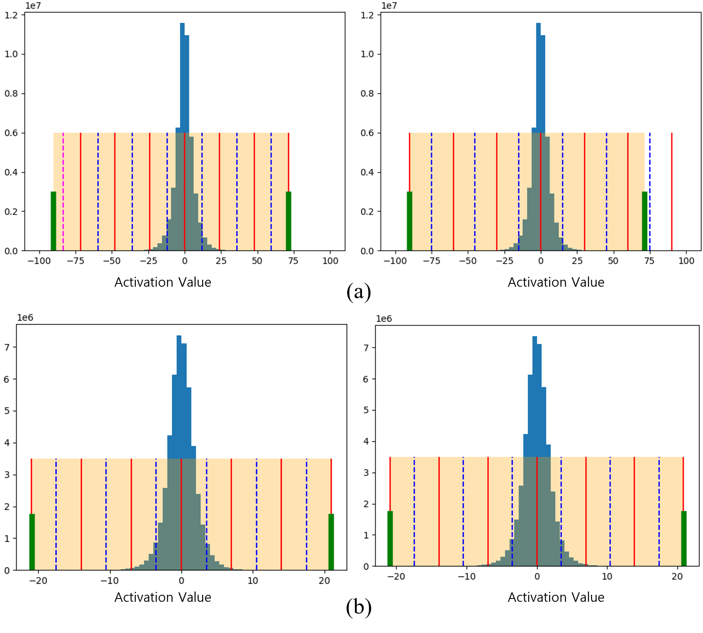
Limit of Quantization Unfitness
Conv
ReLU
Conv
Conv
BN
ReLU
Conv
BN
EDSR
EDSR + BN
Activation of EDSR
Activation of EDSR+BN
Wider quantization gap
Waste of quantization level
Less quantization error!
Notes:
First, as normalization makes activation follow standard normal distribution, it helps removing quantization unfitness.
By looking at left side image, we can easily understand what does the quantization unfitness means.
For many cases, some quantization gap needs to be wider or, some quantization level can be wasted.
Besides, as the activation of bn added model is more gaussian like, the quantization unfitness happen less, which leads reduction of quantization error.

Slide 20
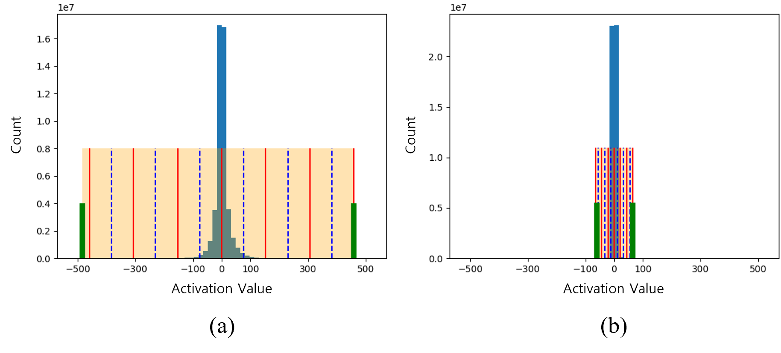
Downscaling of Quantization interval
Conv
ReLU
Conv
Conv
BN
ReLU
Conv
BN
EDSR
EDSR + BN
123.25 / Quantization level
19.5 / Quantization level
Less quantization error!
Notes:
Second, as normalization makes activation follow standard normal distribution, it helps downscaling quantization interval.
For edsr original model, each quantization level should be in charge of a range of 123.25, besides, for normalization added model, the range shrinks as 19.5
As the quantzation interval shrinks, the quantization error can be reduced

Slide 21
Experiments
Experiment Settings
Comparison with PAMS
Comparison with DDTB
Notes:
This is the last chapter, Experiments.

Slide 22
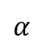
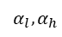
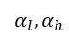
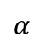
Experiment Settings
Conv
BN
ReLU
Conv
BN
Similar approach applied on IDN
EDSR + BN (EDSR†)
Conv
BN
ReLU
Conv
BN
Conv
BN
ReLU
Conv
BN
Q
Q
Q
Q
Q
Q
Q
Q
$$α$$
$$α$$
$$α_{l},α_{h}$$
$$α_{l},α_{h}$$
EDSR + BN + PAMS
EDSR + BN + DDTB
Notes:
We generated norm added model by adding norm layer right behind of each conv layer.
And quantize the model by two quantization algorithm, PAMS and DDTB.
We applied same approach to IDN, another SR network.

Slide 23
Comparison with PAMS
PAMS shows better performance when BN is included
 | Precision | Urban100 | Test2k | Test4k
EDSR | - | 26.02 | 27.59 | 28.99
EDSR† | - | 25.84 | 27.54 | 28.92
EDSR+PAMS | 8bits | 26.03 | 27.59 | 28.98
+ w/ BN (ours) | 8bits | 25.85 | 27.54 | 28.92
EDSR+PAMS | 4bits | 25.30 | 27.40 | 28.73
+ w/ BN (ours) | 4bits | 25.40 | 27.39 | 28.73
EDSR+PAMS | 3bits | 23.50 | 26.59 | 27.69
+ w/ BN (ours) | 3bits | 25.00 | 27.31 | 28.60
IDN | - | 25.50 | 27.40 | 28.74
IDN† | - | 25.53 | 27.42 | 28.76
IDN+PAMS | 8bits | 25.46 | 27.39 | 28.73
+ w/ BN (ours) | 8bits | 25.50 | 27.41 | 28.75
IDN+PAMS | 4bits | 24.35 | 26.91 | 28.11
+ w/ BN (ours) | 4bits | 24.64 | 27.03 | 28.27
IDN+PAMS | 3bits | 23.24 | 26.36 | 27.44
+ w/ BN (ours) | 3bits | 23.99 | 26.71 | 27.89
Notes:
This is a result for quantizing both model with PAMS. As the precision gets lower, we could find that norm added model gets higher performance.

Slide 24
Comparison with DDTB
DDTB shows better performance when BN is included
 | Precision | Urban100 | Test2k | Test4k
EDSR | - | 26.02 | 27.59 | 28.99
EDSR† | - | 25.84 | 27.54 | 28.92
EDSR+DDTB | 8bits | 26.03 | 27.60 | 28.99
+ w/ BN (ours) | 8bits | 25.81 | 27.54 | 28.92
EDSR+DDTB | 4bits | 25.66 | 27.51 | 28.86
+ w/ BN (ours) | 4bits | 25.55 | 28.49 | 28.85
EDSR+DDTB | 3bits | 25.34 | 27.41 | 28.72
+ w/ BN (ours) | 3bits | 25.31 | 27.42 | 28.75
IDN | - | 25.50 | 27.40 | 28.74
IDN† | - | 25.53 | 27.42 | 28.76
IDN+DDTB | 8bits | 25.02 | 27.26 | 28.53
+ w/ BN (ours) | 8bits | 25.03 | 27.27 | 28.54
IDN+DDTB | 4bits | 24.73 | 27.12 | 28.34
+ w/ BN (ours) | 4bits | 24.74 | 27.13 | 28.37
IDN+DDTB | 3bits | 23.73 | 26.66 | 27.81
+ w/ BN (ours) | 3bits | 24.24 | 26.90 | 28.09
Notes:
This is a result for quantizing both model with DDTB. As DDTB is a asymmetric quantization scheme, the performance gain was smaller than PAMS.
However, the norm added model still gets higher performance as precision gets lower.

Slide 25
Conclusion
Notes:
This is conclusion of our research.

Slide 26
Conclusion
1. Researchs on DCNN-based SR model tend to remove BN from the network
2. Our experiment shows that adding BN can reduce quantization error for low bit precision
3. Problems including high memory requirements and high-frequency component losses still exists
4. Research on new normalization algorithms specialized for quantization needs to be followed up

Slide 27
[1] Dong, Chao, et al. “Image super-resolution using deep convolutional networks,” IEEE Transactions on Pattern Analysis and Machine Intelligence, vol. 38, no. 2, pp. 295-307, 2015.
[2] Ledig, Christian, et al. “Photo-realistic single image super-resolution using a generative adversarial network,” Proceedings of the IEEE/CVF Conference on Computer Vision and Pattern Recognition, 2017, pp. 4681-4690.
[3] Lim, Bee, et al. “Enhanced deep residual networks for single image super-resolution,” Proceedings of the IEEE/CVF Conference on Com- puter Vision and Pattern Recognition Workshops, 2017, pp. 136-144.
[4] Hui, Zheng, Xiumei Wang, and Xinbo Gao, “Fast and accurate single image super-resolution via information distillation network,” Proceed- ings of the IEEE/CVF Conference on Computer Vision and Pattern Recognition, 2018, pp. 723-731.
[5] Choi, Jungwook, et al. “PACT: Parameterized clipping activation for quantized neural networks,” arXiv preprint arXiv:1805.06085, 2018.
[6] Li, Huixia, et al. “PAMS: Quantized super-resolution via parameterized max scale,” Proceedings of the European Conference on Computer Vision, 2020, pp. 564-580.
[7] Kong, Xiangtao, et al. “ClassSR: A general framework to accelerate super-resolution networks by data characteristic,” Proceedings of the IEEE/CVF Conference on Computer Vision and Pattern Recognition, 2021, pp. 12016-12025.
[8] Zhong, Yunshan, et al. “Dynamic dual trainable bounds for ultra- low precision super-resolution networks,” Proceedings of the European Conference on Computer Vision, 2022, pp. 1-18.

Slide 28
Thank You
Q&A
Notes:
Thank you for listening my presentation.
And If you have any question, do not hesitate.

